Slide 1
Module 4
Writing and Solving
Linear Equations

Slide 2
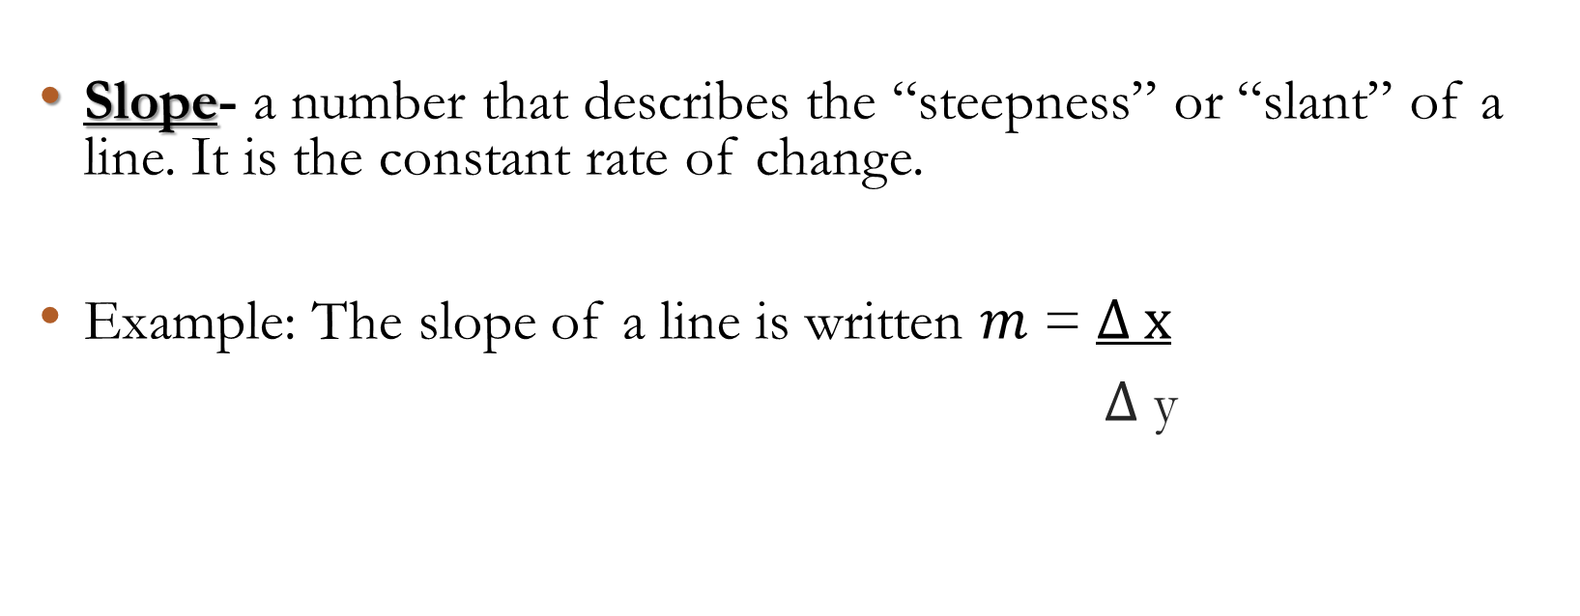
Vocabulary
Slope- a number that describes the “steepness” or “slant” of a line. It is the constant rate of change.
Example: The slope of a line is written 𝑚 = $∆ x$
$∆$ y

Slide 3
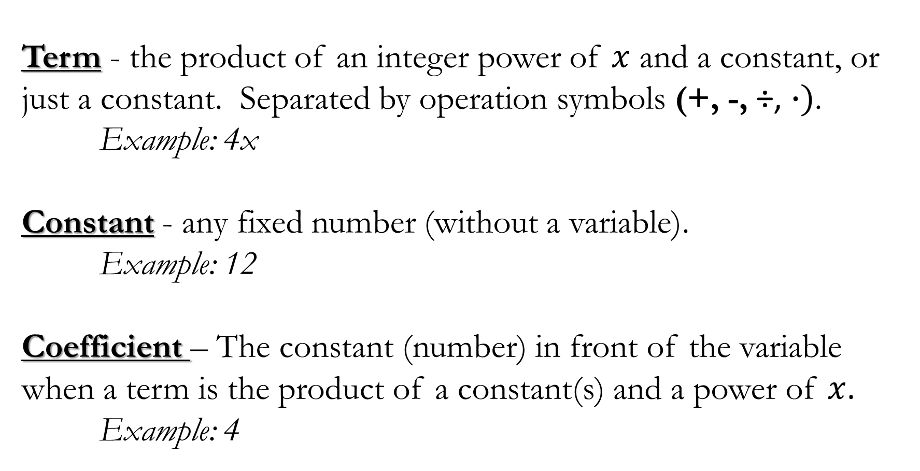
Term - the product of an integer power of $x$ and a constant, or just a constant. Separated by operation symbols (+, -, ÷, $∙)$.
Example: 4x
Constant - any fixed number (without a variable).
Example: 12
Coefficient – The constant (number) in front of the variable when a term is the product of a constant(s) and a power of $x$.
Example: 4

