Slide 1
Linear vs. Non-Linear Expressions

Slide 2
Vocabulary:
Linear Expressions: Sums of constants and products of constants and X raised to a power of 0 or 1.
    Examples: 4 + 3x, 7x + x - 15,
      ½x + 7 - 2

Slide 3
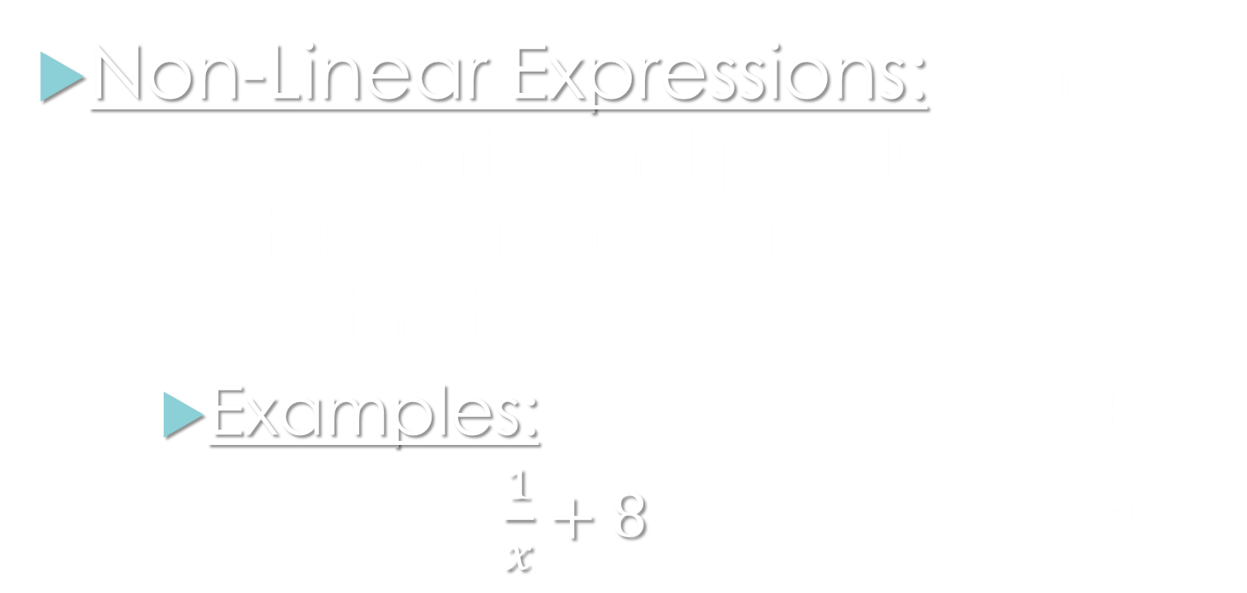
Non-Linear Expressions: Sums of constants and products of constants and X raised to a power that is not 0 or 1.
    Examples: 2x² – 9, -6x⁻³ + 8 + x,
      $\frac{1}{x}+8$ (because this is x⁻¹)

