Slide 1
Similar Triangles

Slide 2
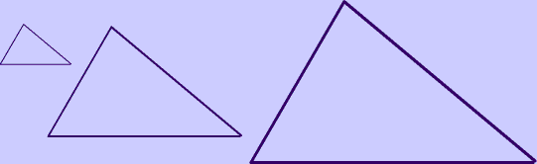
What are similar triangles?
Triangles that have:
Corresponding angles that are congruent.
Corresponding side lengths that are proportional.

Slide 3
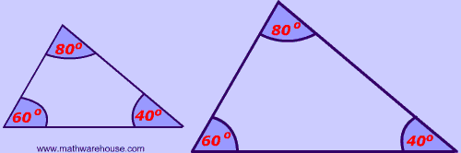
Corresponding Angles are congruent

Slide 4
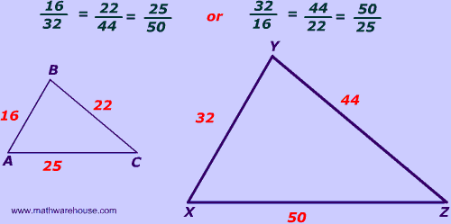
Corresponding sides are proportional

Slide 5
Scale factor
(constant of proportionality)
The ratio between corresponding sides. In the example, the larger triangle's sides are two times the smaller triangles sides, so the scale factor is 2.
16⋅2 = 32
22⋅2 = 44
25⋅2 = 50

