Slide 1
Systems of Equations

Slide 2
A System of Linear Equations is a set of two or more linear equations which are solves or graphed together.
A Solution to a System of Linear Equations is an ordered pair of numbers (x,y) that is a solution to both equations.

Slide 3
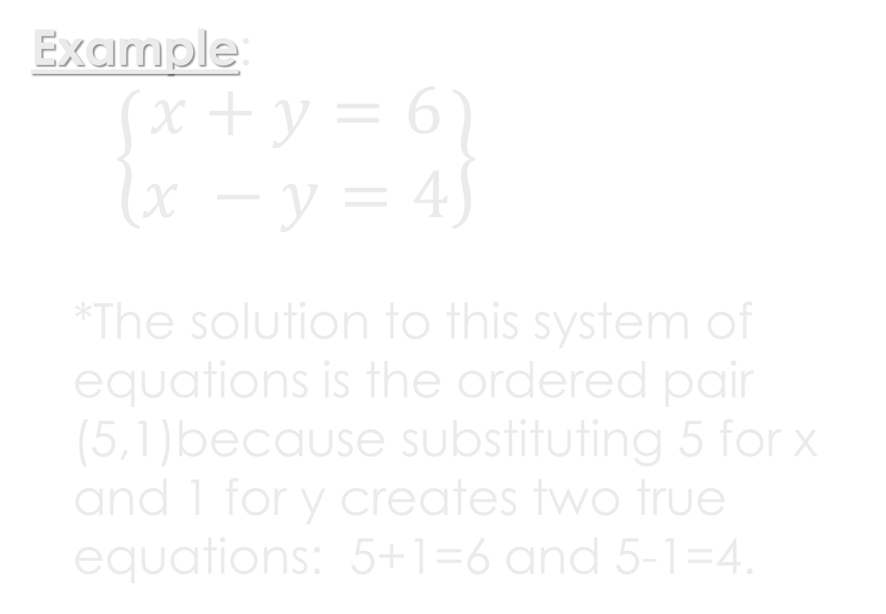
Example:
$\left\{\begin{aligned}x+y=6 \\ x −y=4\end{aligned}\right\}$
*The solution to this system of equations is the ordered pair (5,1)because substituting 5 for x and 1 for y creates two true equations: 5+1=6 and 5-1=4.

Slide 4
Three Methods of Solving Systems of Linear Equations:
1) Graphic
2) Substitution
3) Elimination

Slide 5
Method 1- Solving Systems of Equations Graphically:
Write both equations in Slope-Intercept Form (y=mx+b).
Graph both lines on the same coordinate plane.
The ordered pair (x,y) where the lines intersect is the solution to the system of equations.
Verify the solution by substituting the x and y values of the ordered pair into the original equations and check for equivalence.

Slide 6
Parallel Line Theorem:
Two distinct, non-vertical lines in the plane are parallel if they have the same slope and different y-intercepts.
Parallel lines do not intersect, and therefore a system of equations with parallel lines, has NO SOLUTION.
Verify that lines are parallel by comparing their slopes and y-intercepts.

Slide 7
Method 2- Solving Systems of Equations Using Substitution:
If two expressions are equal to the same value, then they can be written equal to one another.
Solve both equations for y.
Set them equal to each other because they are both equal to y.
Solve for x.
Substitute the value of x into the equation to find the value of y.
Once you have values for x and y, you have solved the system of equations.

Slide 8
Example of Substitution:
y= 5x – 8
y = 6x + 3
Since both equations are equal to y, they are equal to each other.
5x – 8 = 6x + 3
-5x -5x
-8 = x + 3
-3 - 3
-11 = x
Substitute -11 for x, and solve for y. Y = 5 (-11) – 8
  y = -55 – 8
  y = -63
  The SOLUTION to the system of equations is (-11, -63).

Slide 9
Method 3- Solving Systems of Equations Using Elimination:
Write the system of equations vertically (stacked) lining up the like terms (x’s with x’s and y’s with y’s).
Add the equations so that one of the variables and its opposite cancel each other out and become zero.
This leaves you with one variable. Solve for this variable.
When you get a value for the 1st variable, substitute it into the equation to find the value of the 2nd variable.
When you have values for x and y, you have solved the system of equations.

Slide 10
Example of Elimination:
2x + y = 8
x + y = 10
Multiply the 2nd equation by -2 to make opposites and eliminate the variable x:
-2(x +y = 10) = -2x - 2y = -20
Write the equations vertically (stacked) and add them:
  2x + y = 8
  + -2x – 2y = -20
  -1y = -12
  -1 -1
  y = 12
  Substitute 12 for y in the equation, and solve for x. X + 12 = 10 , therefore x = -2
  The SOLUTION to the system of equations is (-2,12).

