Slide 1
Unit 5: Geometric
Transformations

Slide 2
Transformation- a change in position, shape, or size of a figure.
Image- the figure you get after a transformation (original point A has an image of A’).

Slide 3
Three Types of Transformations:
Translation (slide)
Reflection (flip)
Rotation (turn)

Slide 4
Translation- a transformation that moves each point of a figure the same distance AND in the same direction (SLIDE).
Reflection- a transformation that flips a figure over a line and creates a mirror image (FLIP).

Slide 5
Line of Reflection- the line which a figure is reflected over.
Reflectional Symmetry- a figure can be reflected over a line so that its image matches the original figure.
Line of Symmetry- If you fold a figure along this line, the two halves match exactly.

Slide 6
Rotation- a transformation that turns
a figure about a fixed point (TURN).
Center of Rotation- the fixed point
that a figure is rotated around.
Angle of Rotation- the number of
degrees the figure rotates.

Slide 7
Rotational Symmetry- A figure can be rotated 180 degrees or less, and exactly matches its original figure.
*Every figure can be rotated 360 degrees to match its original figure exactly.

Slide 8
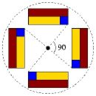
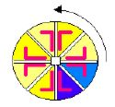
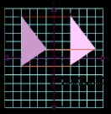
Examples:
Reflections:
Rotations:
Translations:

