Slide 1
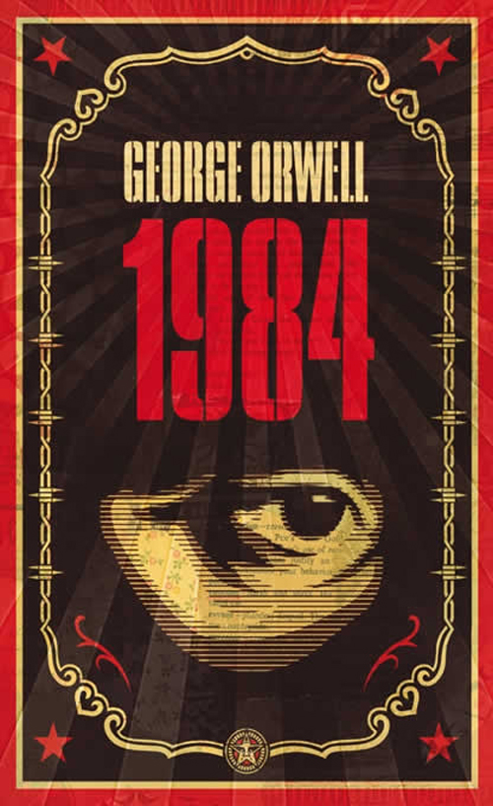
Nineteen Eighty Four by George Orwell

Slide 2
The author:
Born Eric Blair 1903, died George Orwell 1949.
Classical education at Eton - won scholarship
Worked as a Colonial Officer in Burma – resigned 1927
  he hated authority
  he hated injustice
  ‘I knew I had a facility with words and a power of facing unpleasant facts.’ The Hanging.

Slide 3
Nineteen Eighty Four is a satire (the use of humor, irony, exaggeration, or ridicule to expose and criticize people's stupidity or vices, particularly in the context of contemporary politics and other topical issues) on trends in international politics at the end of WW2.
Orwell’s intention is to draw attention to the oppression and cruelty as he saw in Nazi Germany, Soviet Russia, and even the behaviour of some Western countries.

Slide 4
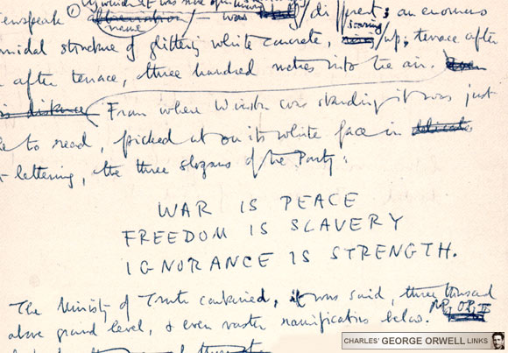
Slogans of “The Party”

Slide 5
Context of Nineteen Eighty-Four.
based on Soviet Russia and Nazi Germany.
Most details are from Nazi Germany.
Once a goal is reached in a totalitarian society, it is replaced immediately by another.

Slide 6
As its name suggests, Totalitarianism is a political system that strives to regulate nearly every aspect of public and private life. Orwell’s Totalitarian society (Ingsoc) was aimless – “we are interested solely in power...if you want a picture of the future...imagine a boot stamping on a human face – for ever.” (O’Brien pg 280)

Slide 7
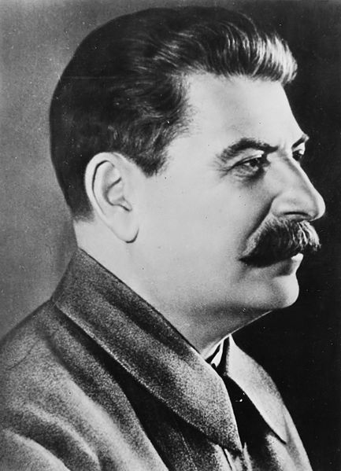
Joseph Stalin
(born Iosef Besarionis dze Jughashvili )
18 December 1878 – 5 March 1953)

Slide 8
Stalin was the General Secretary of the Communist
Party of the Soviet Union's Central Committee from 1922 until his death in 1953. In the years following Lenin's death in 1924, he rose to become the leader of the Soviet Union.
.

Slide 9
During the late 1930s, Stalin launched the Great Purge (also known as the "Great Terror"), a campaign to purge the Communist Party of people accused of corruption or treachery; he extended it to the military and other sectors of Soviet society. Targets were often executed, imprisoned in Gulag labour camps or exiled. In the years following, millions of ethnic minorities were also deported.

Slide 10
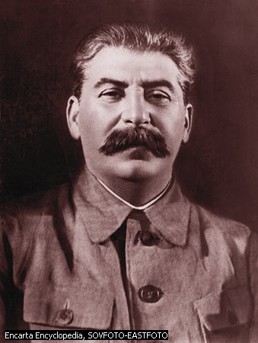
Big Brother is Watching YOU
The face of a man...with a heavy black moustache and ruggedly handsome features Pg 3, 1984

Slide 11

Background to Nineteen Eighty-Four
The world of Nineteen Eighty-Four is based upon two totalitarian dictatorships, Soviet Russia and Nazi Germany.
The world of Ingsoc (English socialism) bears strong resemblances to the Soviet Union, but much of the details are based on Nazi Germany.

Slide 12
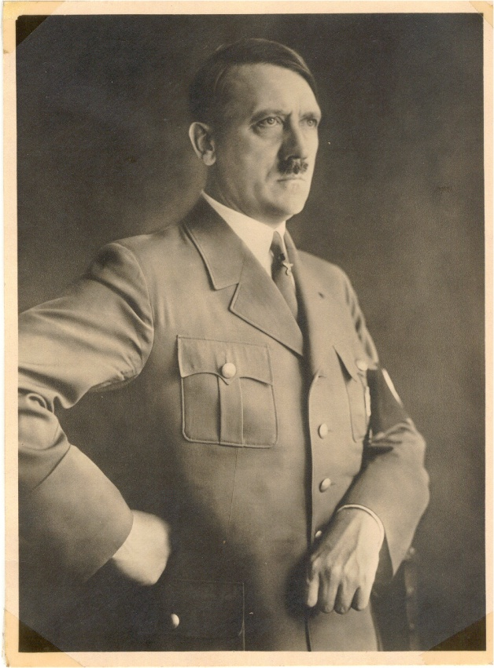
Nazi Germany
EVER since I have been scrutinizing political events, I have taken a tremendous interest in propagandist activity. I saw that the Socialist-Marxist organizations mastered and applied this instrument with astounding skill. And I soon realized that the correct use of propaganda is a true art which has remained practically unknown to the bourgeois parties.
Mein Kampf by Adolf Hitler
Volume One - A Reckoning

Slide 13
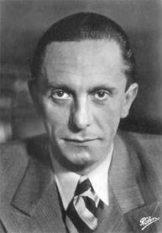
We do not intend to use the radio only for our partisan purposes. We want room for entertainment, popular arts, games, jokes and music. But everything should have a relationship to our day. Everything should include the theme of our great reconstructive work, or at least not stand in its way. Above all it is necessary to clearly centralize all radio activities, to place spiritual tasks ahead of technical ones, to introduce the leadership principle, to provide a clear worldview, and to present this worldview in flexible ways.
- Goebbels

Slide 14
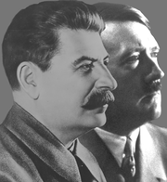
Like Stalin, Adolph Hitler denied his subjects access to the truth. His Third Reich “can be read as a war against memory – an Orwellian falsification of reality...” (Primo Levi) Oceania conducts an unceasing war on memory-evidence that conflicts with the latest official line is systematically destroyed & a false trail is laid in its place.

Slide 15

Surveillance and control
The people of this society are constantly being watched by telescreens (monitors that have an ability to project images and take in images)
They are also watching each other. Any small facial gesture or sigh can give you away.
It doesn’t matter if you are innocent

Slide 16
Big Brother is Watching
YOU

Slide 17
Children of the revolution
In the Soviet Union, young people were encouraged to join the political group. They were called Young Pioneers (aged between 7-13).
If you were a Young Pioneer member you got into university automatically, so there was great pressure to join.

Slide 18

Hitler Youth
"My teaching is hard. Weakness has to be knocked out of them. In my Ordensburgen a youth will grow up before which the world will shrink back. A violently active dominating, intrepid, brutal youth - that is what I am after". Youth must be all those things. It must be indifferent to pain. There must be no weakness or tenderness in it. I want to see once more in its eyes the gleam of pride and independence of the beast of prey. "I will have no intellectual training. Knowledge is ruin to my young men.

Slide 19
What does this remind you of?
“How easy it was, thought Winston, if you did not look about you, to believe that the physical type set up by the Party as an ideal, - tall muscular youths and deep bosomed maidens, blond haired, vital, sunburnt, carefree –existed and even predominated”
Nineteen Eighty-Four (p63).

Slide 20
Some themes…
The lack of privacy
The dangers of totalitarianism
The destruction of history.
The essential nature of memory.
An appreciation of the past.
The ultimate unreliability of the human mind/memory
Technology and Modernization
The use of language
Rebellion

Slide 21
Oceania –
One of the 3 Superstates. (Political System: Ingsoc) Winston Smith's home. Comprised of North and South America, Britain, Australia, and southern portions of Africa. Newspeak is the official language of Oceania, but standard English is still spoken by many.

Slide 22
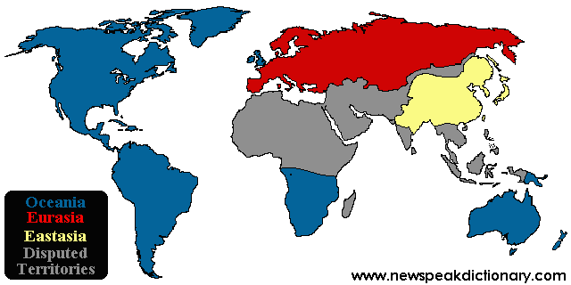
The Three Superstates

Slide 23
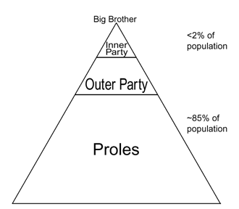

Slide 24
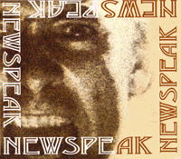
Newspeak
Newspeak, the "official language" of Oceania, is extraordinary in that its vocabulary decreases every year; the state of Oceania sees no purpose in maintaining a complex language, and so Newspeak is a language dedicated to the "destruction of words." As the character Syme puts it:

Slide 25
"Of course the great wastage is in the verbs and adjectives, but there are hundreds of nouns that can be got rid of as well... If you have a word like 'good', what need is there for a word like 'bad'? 'Ungood' will do just as well... Or again, if you want a stronger version of 'good', what sense is there in having a whole string of vague useless words like 'excellent' and 'splendid' and all the rest of them? 'Plusgood' covers the meaning, or 'doubleplusgood' if you want something stronger still.... In the end the whole notion of goodness and badness will be covered by only six words; in reality, only one word."
(Part One, Chapter Five)

